Slide 1
Fair contribution by all digital players
A RIPE Cooperation Working Group community response to a part of the European Commission consultation:
The future of the electronic communications sector and its infrastructure

Slide 2
History / context
ITU World Conference on International Telecommunications (2012)
BEREC report ‘An assessment of IP interconnection in the context of Net Neutrality’ (2012)
European Commissioner Neelie Kroes: “Adapt or die” (2014)
…
What’s new? We thought this idea had died…

Slide 3
Why this ‘exploratory’ consultation?
Inspiration, a political consensus in the EU (January 2022) that:
’We commit to developing adequate frameworks so that all market actors benefiting from the digital transformation assume their social responsibilities and make a fair and proportionate contribution to the costs of public goods, services and infrastructures, for the benefit of all people living in the EU.’
Notes:
From European Declaration on Digital Rights and Principles
Consensus 🡪 Declaration signed by European Commission, European Parliamen and the Council

Slide 4
What is this ‘exploratory’ consultation about?
‘The aim is to gather views on the changing technological and market landscape and how it may affect the sector for electronic communications. It also touches upon the types of infrastructure and amount of investments that Europe needs to lead the digital transformation in the coming years.’
Notes:
From the Consultation announcement

Slide 5
Why is it relevant to the RIPE community?
Following the European Declaration, a call from ETNO members Telefonica, Deutsche Telekom, Vodafone and Orange (February 2022):
‘Digital platforms are profiting from hyper scaling business models at little cost while network operators shoulder the required investments in connectivity. At the same time our retail markets are in perpetual decline in terms of profitability.’
‘We very much welcome the European Commission’s recent commitment to develop adequate frameworks so that “all market players benefiting from the digital transformation (…) make a fair and proportionate contribution to the costs of public goods, services and infrastructures”. We now urgently call upon legislators to introduce rules at EU level to make this principle a reality.’
Supported by ETNO report ‘Europe’s internet ecosystem: socio-economic benefits of a fairer balance between tech giants and telecom operators’ (May 2022)
Notes:
it could lead to a future EU legislative initiative to intervene because of a perceived imbalance that could negatively impact Europe’s ambitions and the necessary investments in Internet infrastructure to achieve these

Slide 6
Why is this relevant to the RIPE community?
For anyone who cares about the Open Internet, they believe that the concept of a “fair share” can have huge negative consequences on the Internet ecosystem
Interconnection is voluntarily agreed – it is based on the mutual agreement to exchange traffic.
It is a low-cost and best effort arrangement that has worked for decades without the need for any regulatory intervention.
Notes:
‘

Slide 7
Why is this relevant to the RIPE community?
Autonomous networks should be free to peer with other networks based on local needs - the “fair share” seeks to change this.
In the Internet no network is - or is supposed to be - more important than another. Yet, the “fair share” considers access networks more important, creating the conditions to reinstate “termination monopoly” that existed under the telephone system.

Slide 8
Why is this relevant to the RIPE community?
Currently, there is a necessary financial and market separation of concerns between the functions of connectivity from the delivery of an application
Each layer in the digital network pays for itself ( this may differ )
It is a concern where cross-subsidies occur. e.g. from an application revenue to a lower layer connectivity function.
This creates market distortions, unfair competition, user capture, failure to serve innovation as well as arbitrary technical damage.

Slide 9
Timeline
European Declaration on Digital Rights and Principles (January 2022)
Telco’s/incumbents call for contribution by large content providers (February 2022)
ETNO commissioned report on fairer balance between tech giants and telecom operators (May 2022)
EC Consultation (23 February 2023 – 19 May 2023) (Uploaded)
Following the consultation: EC Recommendations? (TBD)
New EC: legislative proposal? (TBD)

Slide 10
RIPE Cooperation Working Group: small task team:
Patrik Fältström
Frode Sørensen
Konstantinos Komaitis
Thomas Lohninger
Carsten Schiefner
Alex de Joode
Christian de Larrinaga
Chaired by Desiree Miloshevic, support by Bastiaan Goslings

Slide 11
Agenda
Core Principles (Alex)
Question 54 (Frode)
Part C (Carsten/Christian)
How Trafic and Money flows (Patrik)

Slide 12
Core Principles
3 core principles for internet trafic exchange
Netneutrality Principle
No discrimination of certain traffic (all traffic is equal)
Network resilience Principle
A diverse set of networks, traffic can route around disturbances
Internet model with Autonomous Networks
Every network is responsible for it’s own network: also for the financial part!

Slide 13
Q54 of Commission’s Exploratory Consultation
The European Declaration on Digital Rights and Principles states that all digital players benefiting from the digital transformation should contribute in a fair and proportionate manner to the costs of public goods, services and infrastructures to the benefit of all people living in the EU. Some stakeholders have suggested a mandatory mechanism of direct payments from CAPs/LTGs to contribute to finance network deployment. Do you support such suggestion and if so why? If no, why not?
CAPs = Content and Application Providers
LTGs = Large Traffic Generators

Slide 14
Answer Q54 of Commission’s Exploratory Consultation
The quote “contribute in a fair and proportionate manner to the costs of public goods, services and infrastructures” - does not only indicate that CAPs might contribute to ISPs (“infrastructures”), - but also indicates that ISPs might contribute to CAPs (“good, services”). - It is necessary to take the whole internet ecosystem into account. - ISPs and CAPs are mutually dependent on each other. - CAPs contribute content and applications, as well as platforms and network infrastructure. - Finally, end-users contribute through their internet access subscriptions.
In case a “mandatory mechanism of direct payments” were introduced, a termination monopoly will emerge, which ISPs with end-users connected may exploit, such market development will need regulatory oversight, and regulatory intervention may be needed (ref. termination monopoly in telephony networks).
For these reasons, among others, there should be no such mandatory payment mechanism.

Slide 15
Civil Society Materials
Full Response to exploratory consultation
Policy Paper about the debate
Open Letters: 1st Global Open Letter, 2nd letter about the process, Todays Third letter from Industry, Rightsholders, Broadcasters, Consumer Orgs and NGOs
Full document pool

Slide 16
What do stakeholders say
The European Consumer Organisation, https://www.beuc.eu/sites/default/files/2022-09/BEUC-X-2022-096_Connectivity_Infrastructure-and-the_open_internet.pdf
BEREC preliminary assessment of the underlying assumptions of payments from large CAPs to ISPs - https://www.berec.europa.eu/en/document-categories/berec/opinions/berec-preliminary-assessment-of-the-underlying-assumptions-of-payments-from-large-caps-to-isps
European Internet Exchange Points (EU IX): https://www.euro-ix.net/en/services/regulatory/
Members of the European Video on Demand coalition share their position on content delivery and net neutrality: https://www.europeanvodcoalition.com/positions/position-paper-on-net-neutrality/
Mobile Virtual Operators Europe Position Paper http://mvnoeurope.eu/wp-content/uploads/MVNO-Europe-Position-on-contributions-to-network-investment-3008.pdf
Germany, Denmark, the Netherlands, Estonia, Austria, Finland, Belgium - concerns over the necessity of the proposal and its impact.

Slide 17
Background material
European Commission Consultation on The future of the electronic communications sector and its infrastructure
European Declaration on Digital Rights and Principles
A call for large content platforms to contribute to the cost of the European digital infrastructure that carries their services
ETNO report Europe’s internet ecosystem: socio-economic benefits of a fairer balance between tech giants and telecom operators
Positions by different stakeholders on the “fair share” debate

Slide 18
How traffic and money flows on the internet
Cooperation Working Group Small Task Team

Slide 19
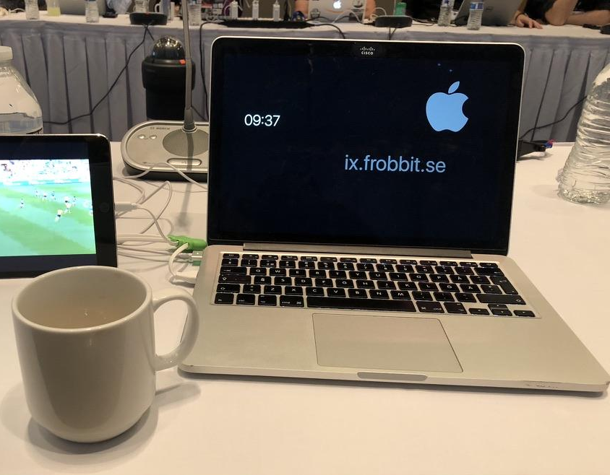
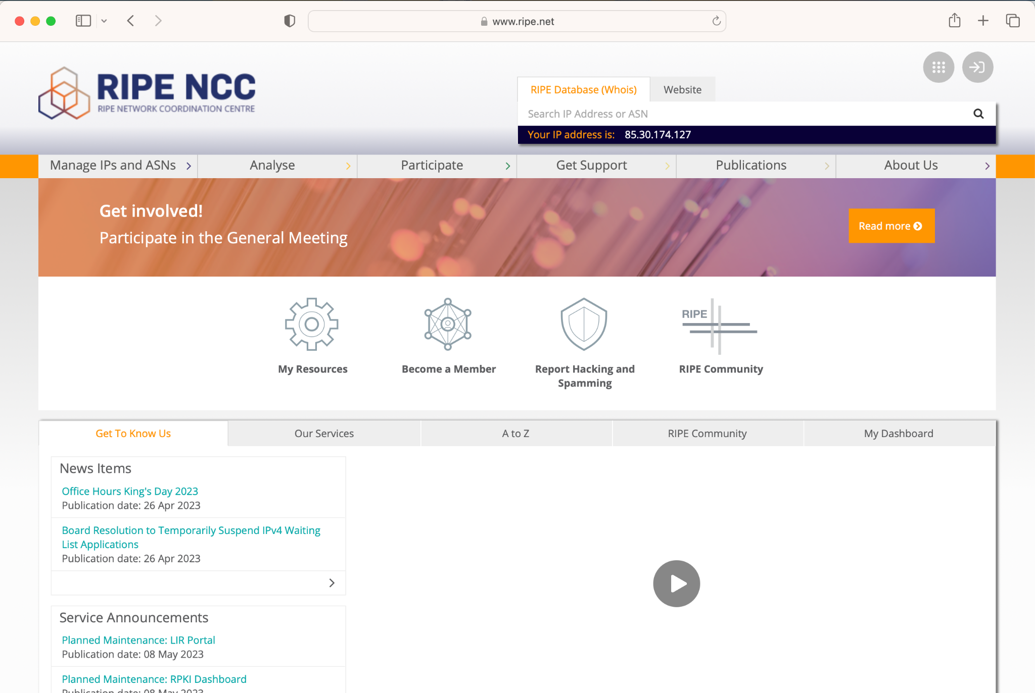
Traffic flow on the Internet
Operator 2
Operator 1

Slide 20
Traffic flow on the Internet
Operator 2
Company pays for this!
Operator 1
End user pays this!

Slide 21
Traffic flow on the Internet
Operator 2
Company pays for this!
Operator 1
How do operators agree on this transaction?
End user pays this!

Slide 22
Why exchange traffic in the first place?
One provider can never have all customers
Providers will also have different customer segments, eyeballs, companies, colocation, banks etc
Situations will occur when a provider with a limited footprint wants to exchange traffic with a provider with a larger footprint
A simplified model is:
Peering is exchange of traffic for free
Transit is exchange of traffic for a fee
Money flows in one direction only
Notes:
Should we differentiate private and public peering (at IXP level)? Too complicated for THIS deck of slides which only is an introduction I think…
See slide 30.

Slide 23
Why pay for traffic?
An operator with a larger footprint will have to transport the traffic over a longer distance
The cost for maintaining the larger network is higher
In principle the transit charges are comparable to transport costs
An operator with a significantly larger customer base have had larger costs for building out infrastructure
Traffic fees are paid from the smaller to the larger

Slide 24
Why not pay for traffic?
If two providers consider their network footprint, cost, and traffic volumes more or less equal, sending invoices in one or both directions are unnecessary under the assumption they will be of equal monetary value
If you have multiple parties that are equal - a free exchange of traffic - peering will lower your transit costs
Money saved on transit can be invested in better peering infrastructure for the benefit of end users

Slide 25
Peering
A
C
Peering
Transit
B
A and its customers can reach B and C
B and its customers can reach A
C and its customers can reach A

Slide 26
Transit
A
C
Peering
Transit
B
A and its customers can reach B and C
B and its customers can reach A and C
C and its customers can reach A and B

Slide 27
In reality
Other players
A
C
Peering
Transit
B
A and its customers can reach B and C (and other things)
B and its customers can reach A and C (and other things)
C and its customers can reach A and B (and other things)

Slide 28
Payments / traffic
Other players
A
Y Mbps
C
X Mbps
Peering
Transit
B
A and its customers can reach B and C (and other things)
B and its customers can reach A and C (and other things)
C and its customers can reach A and B (and other things)

Slide 29
Payments / traffic
Other players
A
Y-Z Mbps
C
X-Z Mbps
Peering
Transit
Z Mbps
B
A and its customers can reach B and C (and other things)
B and its customers can reach A and C (and other things)
C and its customers can reach A and B (and other things)

Slide 30
Payments / traffic
Other players
A
€Y
C
€X
Peering
Transit
B
A and its customers can reach B and C (and other things)
B and its customers can reach A and C (and other things)
C and its customers can reach A and B (and other things)

Slide 31
Payments / traffic
Other players
A
€Y' instead of €Y
Is (€Y' + €Z') < €Y?
C
€X' instead of €X
Peering
Transit
Is (€X' + €Z') < €X?
€Z', but is Z' zero?
If not, is it positive or negative?
B
A and its customers can reach B and C (and other things)
B and its customers can reach A and C (and other things)
C and its customers can reach A and B (and other things)

Slide 32
Hybrid models
There are also hybrid models, for example “paid peering”
When a single dominant player (mostly current or former monopolies) charges others operators for sending and receiving traffic to the dominant players customers
The cost is lower - and access is limited to the dominant players customers - not the rest of the Internet

Slide 33
The value of traffic
In peering discussions it mostly comes down to valuing traffic in each direction
The first criteria often used is that in/out should be in balance - but this depends on the peer
For peers with content (rather than large number of eyeballs) localization of traffic might have value in itself
But content is also often considered potential customers
IMPORTANT: The internet model of payment settlement is only based on value of traffic

Slide 34
Traffic flow on the Internet
Operator 2
Based on value of traffic
Company pays for this!
Operator 1
End user pays this!

Slide 35
Traffic flow on the Internet
Operator 2
Based on value of traffic
Company pays for this!
Operator 1
End user pays this!
Who pays for this?

Slide 36
Traffic flow on the Internet, in reality
Operator 2
Based on value of traffic
Based on value of traffic
RIPE
Operator 1
End user pays this!
Company pays for this!
Based on value of traffic

