Slide 1
ASO AC Update
RIPE 86, Rotterdam
24th May 2023
Notes:
1
1
1

Slide 2
ICANN ASO AC (Address Council)
Who is it? | The NRO Number Council
What is it? | Number Resource Policy Advisory Body
How is it Organized? | 15 Members [3 From Each Region] 2 Elected at Large 1 Appointed by RIR Board
Term of Office? | Different for every RIR
What Does it Do? | Advise ICANN Board Oversee the Global Policy Development Process (GPDP) Appoint ICANN Board Members (2) Appoint member to ICANN NomCom (1)
When Does It Meet? | Remotely – Monthly F2F – Annually
2
Notes:
2
2
2

Slide 3




2023 Address Council Members
REGION | Member | Term
 | Saul Stein | Jan 2021 – 31 Dec 2023
 | Gaurav Kansal Nicole Chan* [Vice Chair] Di Ma | Jan 2023 – 31 Dec 2024 Jan 2023 – 31 Dec 2023 Jan 2022 – 31 Dec 2023
 | Kevin Blumberg* Nick Nugent Chris Quesada | Jan 2022 – 31 Dec 2023 Jan 2023 – 31 Dec 2025 Jan 2022 – 31 Dec 2023
 | Esteban Lescano* Jorge Villa Ricardo Patara [Vice Chair] | Apr 2021 – 31 Mar 2023 Jan 2011 – 31 Dec 2023 Jan 2022 – 31 Dec 2024
 | James Kennedy Sander Steffann Hervé Clément* [Chair] | Jan 2023 – 31 Dec 2025 Jan 2022 – 31 Dec 2024 Jan 2021 – 31 Dec 2023
* Appointed by RIR Board
Notes:
AFRINIC region has 2 seats vacant pending appointment by AFRINIC’s Board

Slide 4
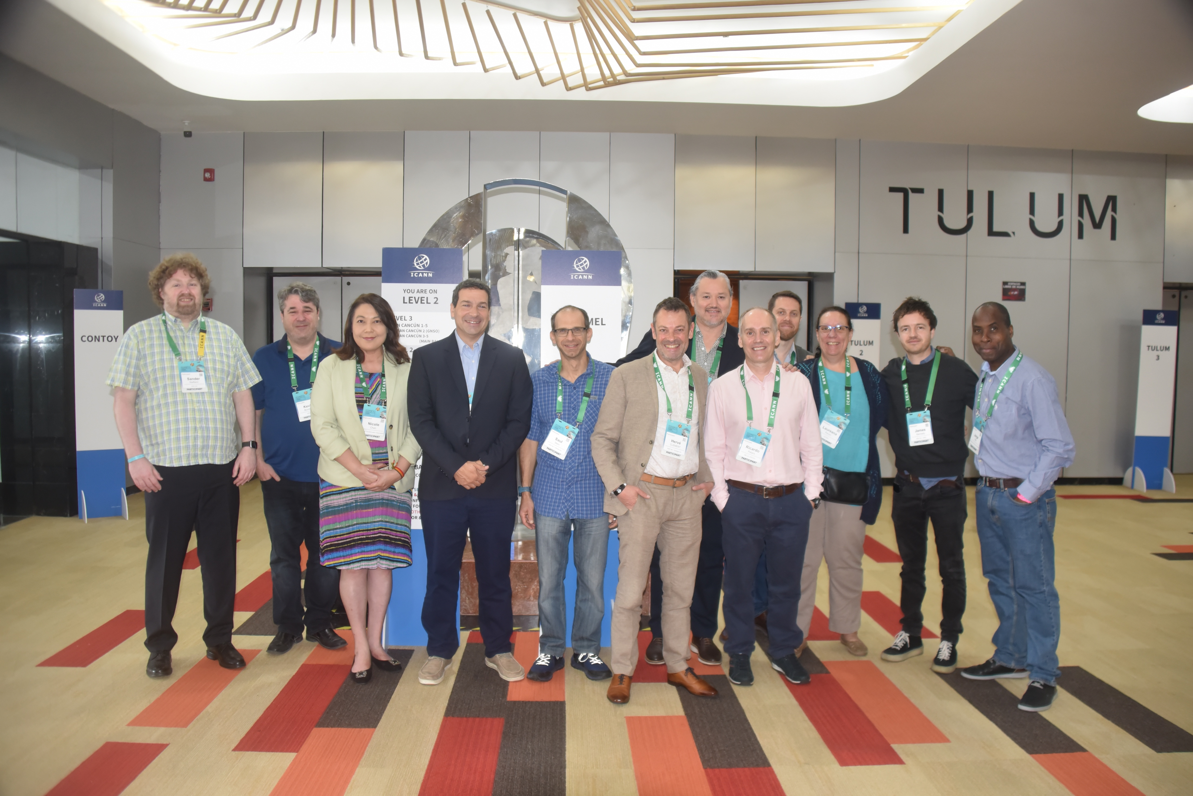
2023 Address Council Members in pictures
Notes:
AFRINIC region has 2 seats vacant pending appointment by AFRINIC’s Board

Slide 5
Global Policy Development
ASO-AC members follow their respective RIR’s policy forum for any proposed
global policy
Global PDP: https://aso.icann.org/policy/global/global-policy-development-process/
Current Global Policies: https://aso.icann.org/policy/global/current-global-policies/
2023 Policy Proposal Facilitator Team (PPFT):
Saul Stein (AFRINIC)
Di Ma (APNIC)
Nick Nugent (ARIN)
Jorge Villa (LACNIC)
James Kennedy (RIPE NCC)
5
Notes:
5
5

Slide 6
ASO AC Transparency
Annual Face to Face – OPEN to observers (Except for discussion related to Elections). ICANN76 Cancún | 11-16 March 2023
AC-DISCUSS mailing archive has OPEN public records
  https://aso.icann.org/pipermail/ac-discuss/
ASO AC Monthly Teleconference OPEN to observers
  Normally First Wednesday of the month at 12:00 PM UTC
  2023 Meeting Calendar https://aso.icann.org/aso-ac/meetings/aso-ac-meeting-schedule/
Annual Transparency Review
  https://aso.icann.org/aso-ac/transparency-review/
Notes:
Zoom url is published in the ASO website
Minutes are public

Slide 7
ASO AC Current Appointments
Alan Barrett (from AFRINIC Region)
  Seat 9 ICANN Board, 2021 – 2024 term
Christian Kaufmann (from RIPE Region)
    Seat 10 ICANN Board, 2022 – 2025 term
Brajesh Jain (from APNIC Region)
  ASO Representative in the ICANN NomCom, 2023 term

Slide 8
ASO AC Operating Procedures Review
ASO AC Operating Procedures currently under review:
  https://aso.icann.org/documents/operational-documents/operating-procedures-of-the-address-council-of-the-address-supporting-organization/
  Started Jun 2022, target completion September 2023
Working group:
  Hervé Clément - (RIPE NCC)
  Gaurav Kansal (APNIC°
  James Kennedy - (RIPE NCC)
  Esteban Lescano - (LACNIC)
  Ricardo Patara - (LACNIC)
  Saul Stein - (AFRINIC)
  Sander Steffann - (RIPE NCC)

Slide 9
Thank you.
Questions?
9
Notes:
9
9

