Slide 1
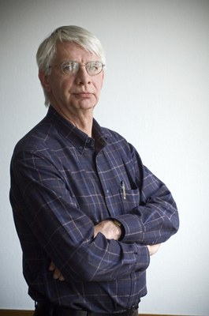
Award Committee 2023 Rob Blokzijl Foundation
https://rob-blokzijl-foundation.org/
RIPE86 Rotterdam, May 25th, 2023
Falk von Bornstaedt
fbornstaedt@benocs.com

Slide 2
Basic Facts
Rob Blokzijl, resigned as RIPE chair in 2013 after serving for 25 years
He died 1 December 2015, aged 72
1 December 2016, the RIPE NCC established the Rob Blokzijl Foundation to honour Rob's legacy by recognising and rewarding individuals who make substantial contributions to the development of the internet in the RIPE NCC service region.
May 2018: The first Award was given to Wilfried Woebber
May 2022: Award given to Gert Döring
November 2023: next award planned

Slide 3
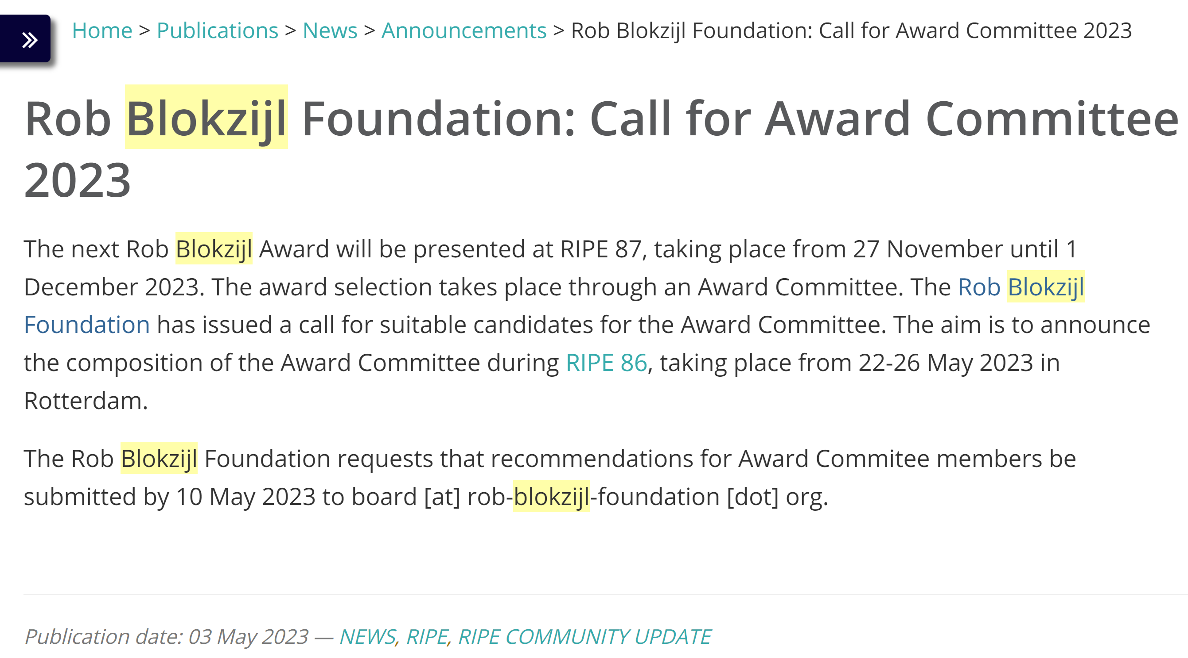
Call for Award-Committee 2023 on the ripe-list and website resulted in 7 volunteers
Von: Fbornstaedt@benocs.com
Sent April 12, 2023
An: ripe-list@ripe.net <ripe-list@ripe.net>
Betreff: Rob Blokzijl Foundation: Call for Award Committee 2023
The next Rob Blokzijl Award will be presented at RIPE 87 between November 27th and December 1st of 2023. Like last time the process will be organised by an Award Committee, which will be appointed in time to be annouced by the board of the foundation at RIPE86 in Rotterdam. The committee will then make a call for nominations and select the next awardee.
We are looking for suggestions for the composition of the Award Committee. Would you like to suggest someone specific or give us some general advice on the Award Committee? Please let us know at board@rob-blokzijl-foundation.org until May 10th, 2023.
Falk von Bornstaedt

Slide 4
Award Committe 2023
1. Maria Häll
2. Julf Helsingius
3. Franziska Lichtblau
4. Desiree Miloshevic
5. Carsten Schiefner
6. Mike Silber
7. Jan Zorz
Will issue a call for nominations.
The committee will review all nominations and may seek clarifying information if needed in the process of the review.

