Slide 1
@RIPE86, 25 May 2023

Slide 2
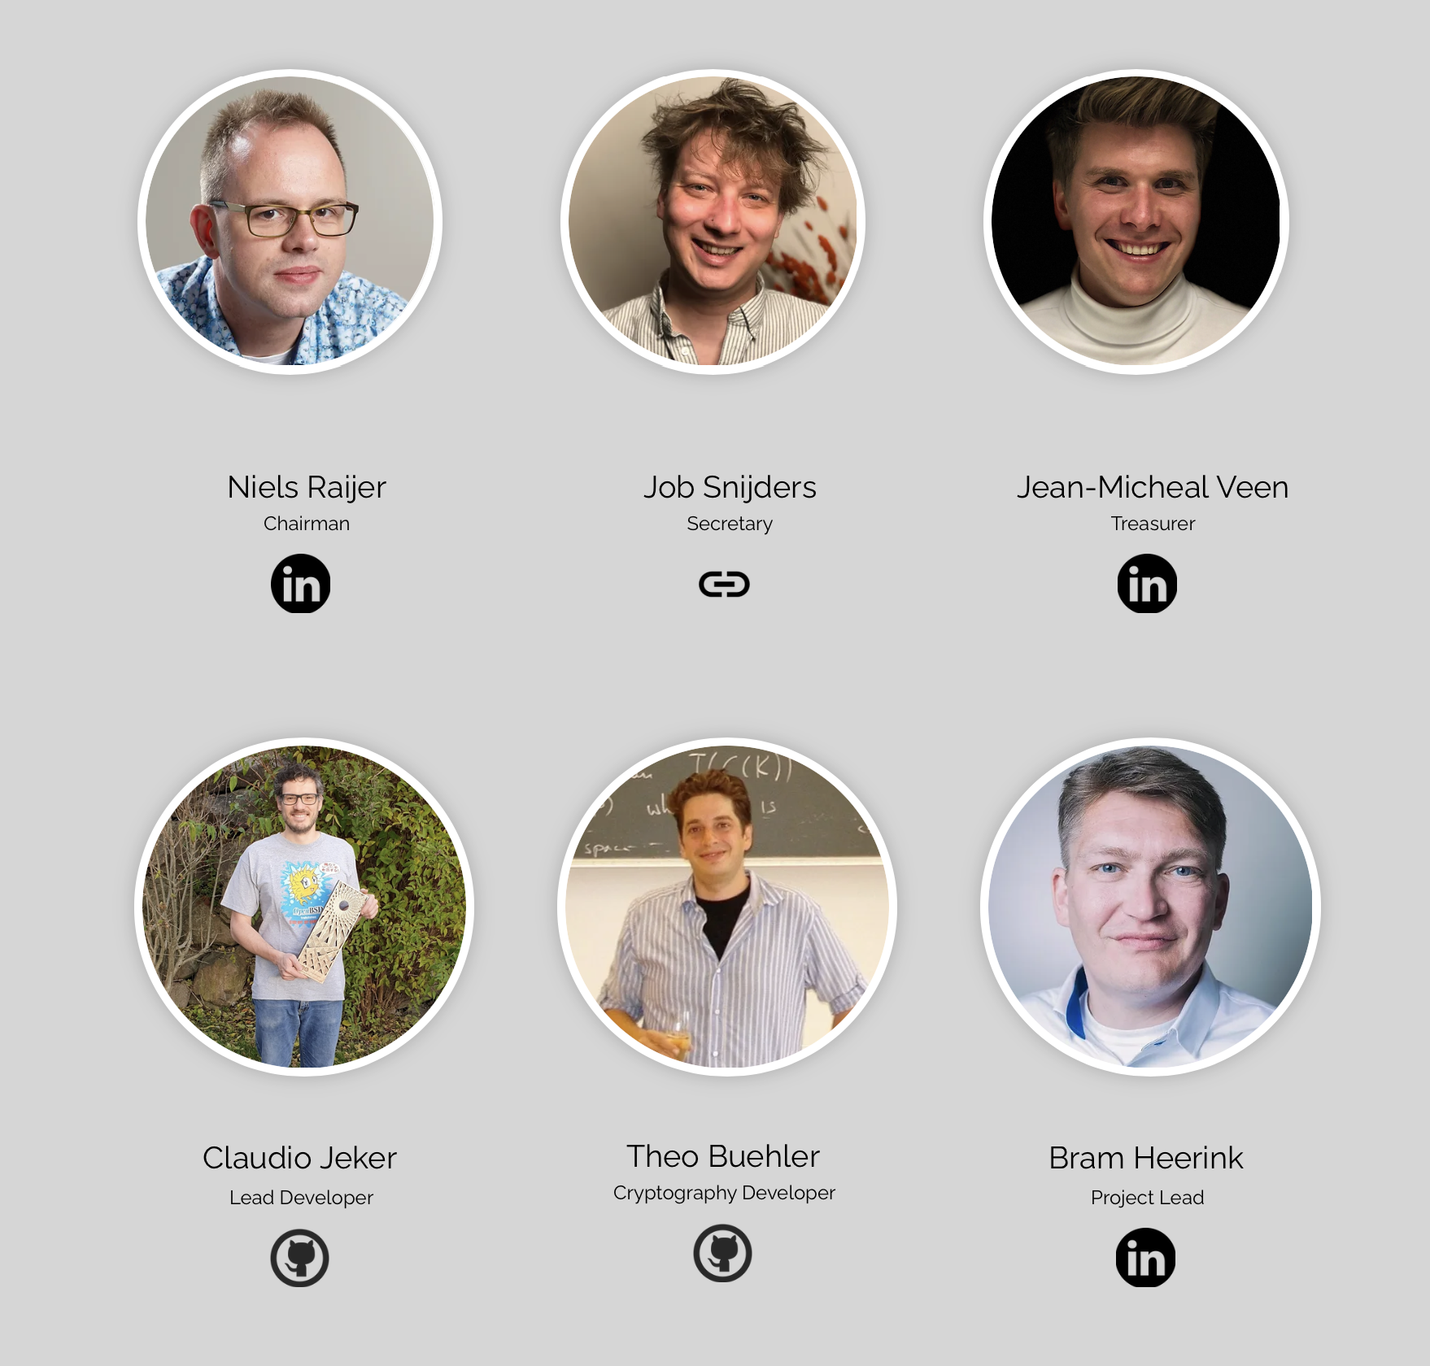
Niels Raijer:
owner of Fusix Networks
chairman of RSSF
vice chairman of NLNOG
founder of Coloclue
… and not a coder!

Slide 3
What we do (1)
RSSF is a formal body (“Stichting”)
Started for providing support on OpenBGPD to our 4 founding members: DE-CIX, Netnod, LINX, AMS-IX, with the goal of diversifying their route servers; roadmap is scale to thousands of peers and implement necessary features

Slide 4
What we do (2)
From the start with support from JPNAP and ISOC
Since December 2022, NL-IX is on board too
Since end of 2022, we offer support on rpki-client, too

Slide 5
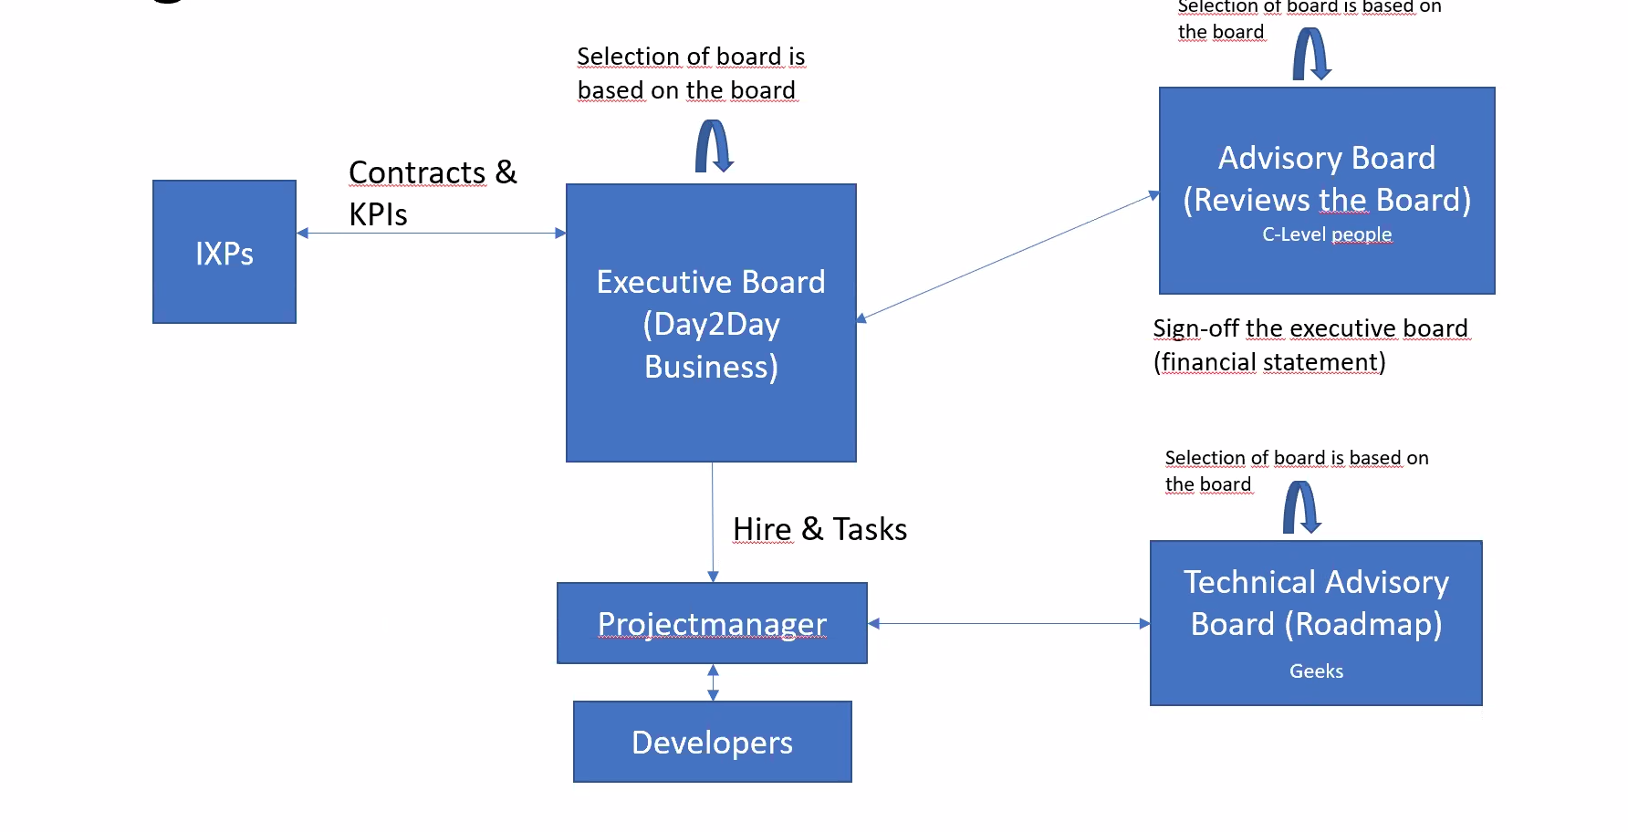
Structure

Slide 6
What we NOT do
Have a secret agenda to shoot the BIRD (the goal is diversity!)
Fork OpenBGPD (new features and capabilities benefit everyone!)

Slide 7
IX developments
Many tests performed and APIs tested
Some of the smaller peering LANs now run on OpenBGPD next to BIRD, and the LINX LON2 LAN does so, too!
On track for introduction of OpenBGPD on other large peering LANs

Slide 8
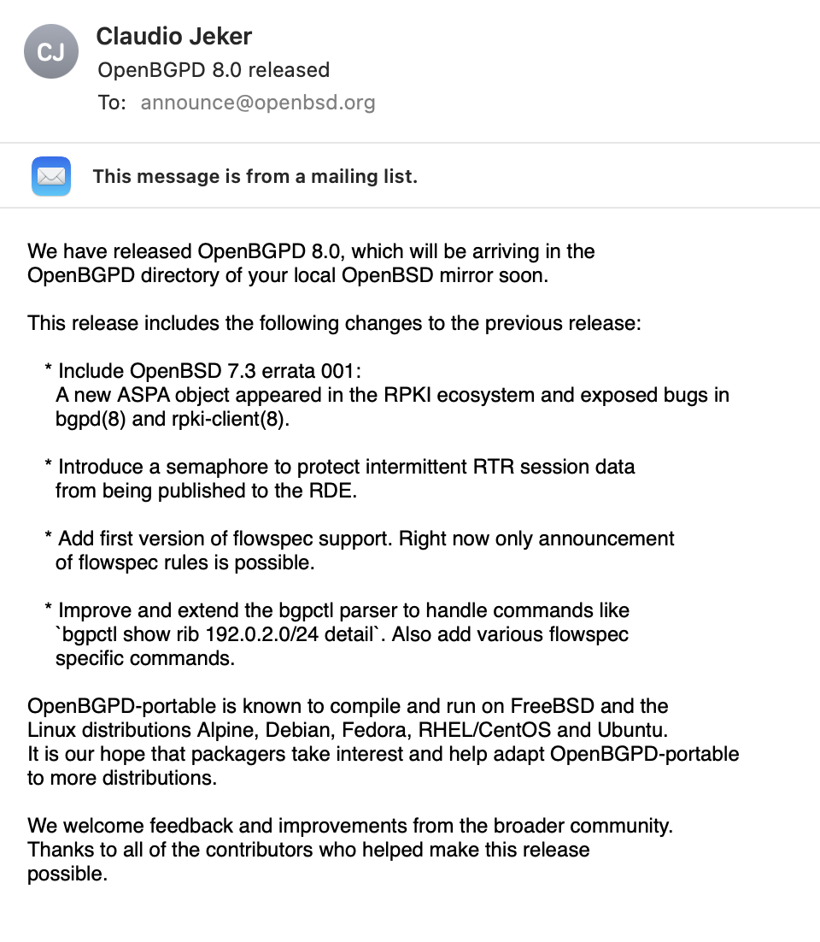
OpenBGPD developments
8
8
8

Slide 9
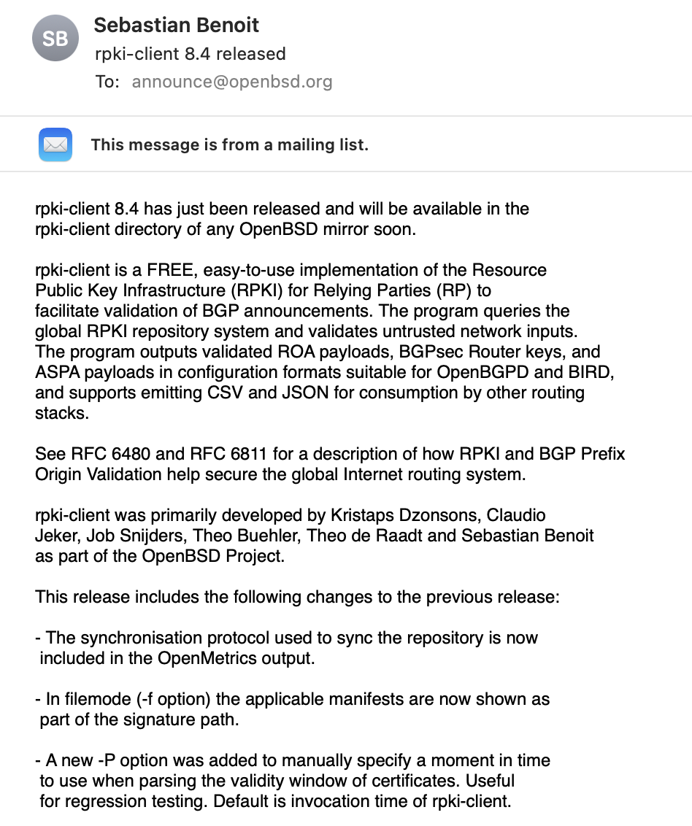
rpki-client developments
9
9
9

Slide 10
Funding from an unexpected source (1)
Pilot round from “Sovereign Tech Fund”
Outlined three OpenBGPD goals:
ASPA support
Improved RDE performance
Improved Linux support
Received funding!
10
10

Slide 11
Funding from an unexpected source (2)
Evaluation conference in Berlin last month
Noted that as a foundation we seemed to be ahead of many other developers; they’re all seeking continuity
The whole process started out easily, ended up with time sheets and paperwork. Trial round joys.
11
11

Slide 12
Funding from an unexpected source (3)
Our three goals are now almost all implemented (yes, that includes ASPA support in OpenBGPD)
STF has additional funding available for a new round and is open to new applications: https://sovereigntechfund.de/
12
12

Slide 13
What we have learned so far
Really happy with the foundation’s structure
Business model was perhaps not the best at the start – rpki-client really helps
The “support” in our foundation’s name has evolved to “work to support development” instead of “help with operations”
Software development stays on track if developers work with peace of mind

Slide 14
Qs?

