Slide 1
Our (in)Secure Web: Understanding Update Behavior of Websites and Its Impact on Security
Nurullah Demir¹, Tobias Urban¹, Kevin Wittek^{1, 2}, Norbert Pohlmann¹
¹ Institute for Internet Security—if(is), Westphalian University of Applied Sciences Gelsenkirchen {lastname}@internet-sicherheit.de
² RWTH Aachen University
Published at: Passive and Active Measurement Conference

Slide 2
• Background • Method • Results • Limitations • Conclusion
Motivation
and many .
3rd parties .
… .

Slide 3
• Background • Method • Results • Limitations • Conclusion
Motivation
Understanding:
how up-to-date are utilized software on the web,
security implications of utilizing outdated software.
Large-scale analysis on 5.6M websites.

Slide 4
• Background • Method • Results • Limitations • Conclusion
Overview on dataset
Dataset:
Historical data of websites (01.2019 - 06.2020)
Release history
Vulnerability database
Dataset preparation & enrichment:
Convert all versions to SemVer format,
drop all records with polluted data

Slide 5
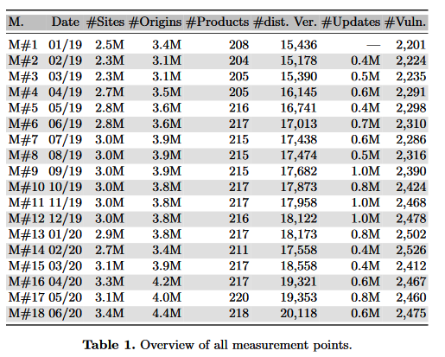
• Background • Method • Results • Limitations • Conclusion
Overview
Our dataset:
5.6M distinct sites,
31.909 releases (Github + manual),
342 distinct SW,
147.312 CVEs.

Slide 6
• Background • Method • Results • Limitations • Conclusion
Update behavior of websites
a median of 3 evaluable software products per website (min: 1, max: 17, avg: 3.37)
94% of all observed websites were not fully updated,
74% of software out-of-date for each website.

Slide 7
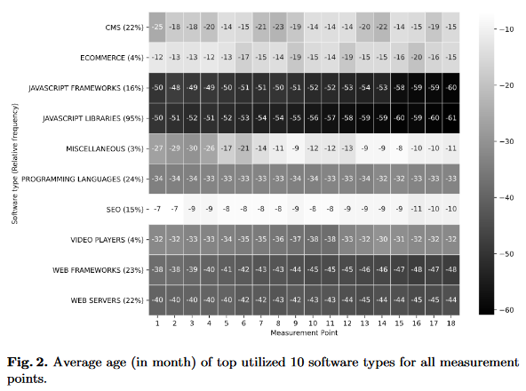
• Background • Method • Results • Limitations • Conclusion
Update behavior from software perspective
AVG age of software 44 months (41 newer releases)

Slide 8
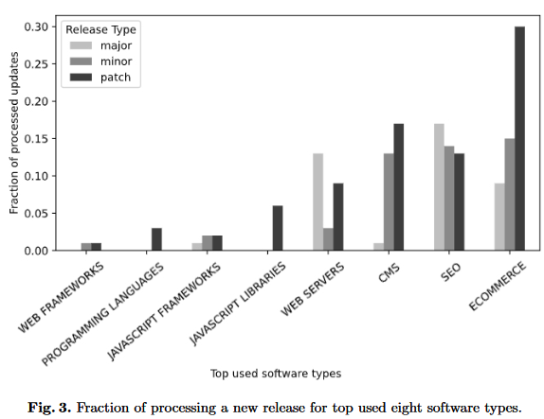
• Background • Method • Results • Limitations • Conclusion
Adoption of SW releases
each month for 67% of software a new release
3.5 months between two updates

Slide 9
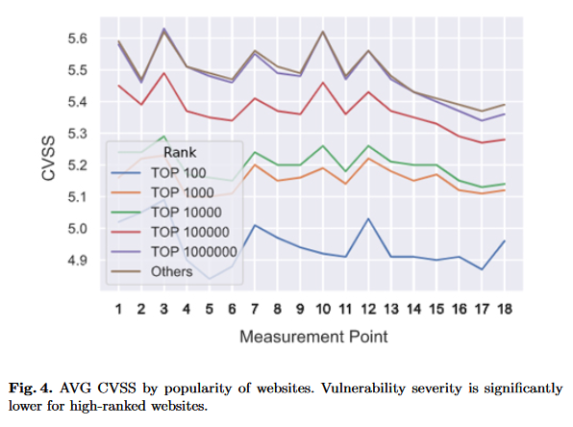
• Background • Method • Results • Limitations • Conclusion
Security Impact of Not Updating
Vulnerability of websites:
94% of websites: at least one vulnerable SW
12% of websites: at least one critical vulnerability (CVSS = 10)
Impact of performing updates: CVSS 6.2 -> 2.4

Slide 10
• Background • Method • Results • Limitations • Conclusion
Limitations of our measurement
HTTPArchive:
only landing pages,
no interaction with websites.
Wappalyzer:
may not detect all used SW
NVD:
discussions & critics
CVE:
No validation

Slide 11
• Background • Method • Results • Limitations • Conclusion
Discussion
Our measurement;
highlights the current state of the Web,
shows the update behavior of websites over the course of 18 month,
shows, most of the utilized software is outdated (by more than four years),
records, 95% of websites potentially contain at least one vulnerable software;
must be seen as an upper bound!
website providers need to take more care about updates.

Slide 12
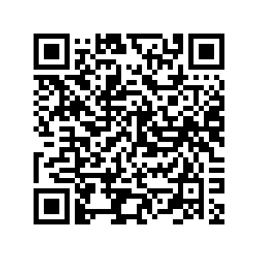
Thank you!
Questions?
Full paper (free access)

