Slide 1
ACCRA INTERNET EXCHANGE (Accra-IX)
Enhancing Ghana’s internet ecosystem and strengthening it’s Digital Economy

Slide 2
Silas Agyepong Peprah
Project Coordinator
info@accra-ix.net | +233207318897

Slide 3
Appreciation
Greetings from Ghana!
I would like to thank and appreciate the great work of the organizers, partners and stakeholders of the RIPE NCC, I wouldn’t have been here if not for your efforts in putting this together, and to the amazing people and friends around here, I really appreciate you, also to Paix and Accra-IX, I appreciate all your efforts in getting me here.
ACCRA-IX

Slide 4
Founding Partners

Slide 5
Profile
The Accra Internet Exchange (Accra-IX) is a Non-Profit organization aimed at building and growing the internet ecosystem through colocation, peering and interconnection in Ghana.
The Accra-IX was founded by a team of internet experts and digital entrepreneurs who understand and are well versed in networking and interconnections.
Through Accra-IX, networks within the region will be able to exchange local traffic among themselves thus reducing the need for expensive international peering traffic. This will also encourage hyper-scalers and content delivery networks to come into the region following the traffic growth at the internet exchange.

Slide 6
Problem Statement and Solution Approach
Internet Service Providers (ISPs) are facing challenges in exchanging traffic efficiently with other networks. These challenges includes:
High latency
High cost of connectivity.
The current situation has additionally impacted and still affecting the digital lives of users and enterprises due to:
High cost of bandwidth
High latencies
Unreliable network services
Unavailability of content
The Introduction of an Internet Exchange Point (IXP) addresses these challenges by:
Providing a neutral platform for ISPs to directly exchange traffic with each another
Having Carriers, CDNs, Cloud and Enterprise networks peer at the exchange.
Cost saving on international transit
Solution
Problem Statement
Setting up and running an IXP require significant investments in terms of:
Infrastructure,
Staffing
Operations
And this is the more reason why exchanges are best built by the community and for the community
IXP

Slide 7
Accra-IX
The Accra-IX is a carrier neutral non-profit internet exchange point in Ghana, built for the community, by the community
Ghana has one of the fastest growing populations in West Africa with the population growing from 24.8m to 31.1m in which represents an annual average growth of 2.2%

Slide 8
Accra-IX
Internet users have grown from 7.96m users in 2017 to 16.99m as of 2022, which represents an increase of 113.5% of internet user growth over the period
There are a total of 6 submarine cables landing in Ghana.
ACE
WACS
GLO-1
MainOne
Sat-3/WACS
2 Africa

Slide 9
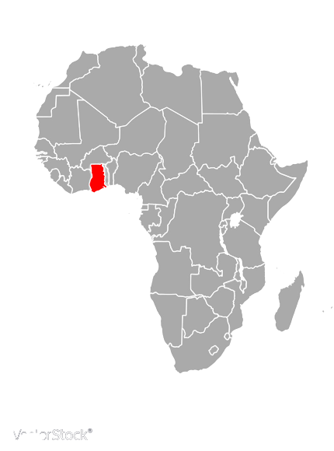
Key Differentiators
Improved Latency: The IX is located in the heart of the internet ecosystem in Accra (PAIX) and offers:
Free Ports (1GB, 10GB, 100GB)
Direct access to local content
Better latency to CNDs within the region
Direct access to eyeball networks
Regional Peer
The objective of the Accra-IX community is to create:
A neutral platform for all
An open peering policy for all community members.
Creating basic and advanced education and awareness for the protection and usage of the internet
Traffic aggregation – keeping Ghanaian traffic in Ghana
Data Sovereignty – local peering enables data sovereignty
Accra
Community Objective

Slide 10
Advantages of Accra-IX to the Ecosystem
Reduced Latency
Through direct interconnectivity, transmission time for data is minimized, thus reducing network latency, making it more efficient.
Better End User Experience
Accra-IX will facilitate better communication, collaboration, control and trust between service providers, thus improving the service/experience provided to the user.
Lower Data Cost
With the reduction of expensive international data traffic and less cross-border data transmission, directly results in a cost savings that benefits the user community.

Slide 11
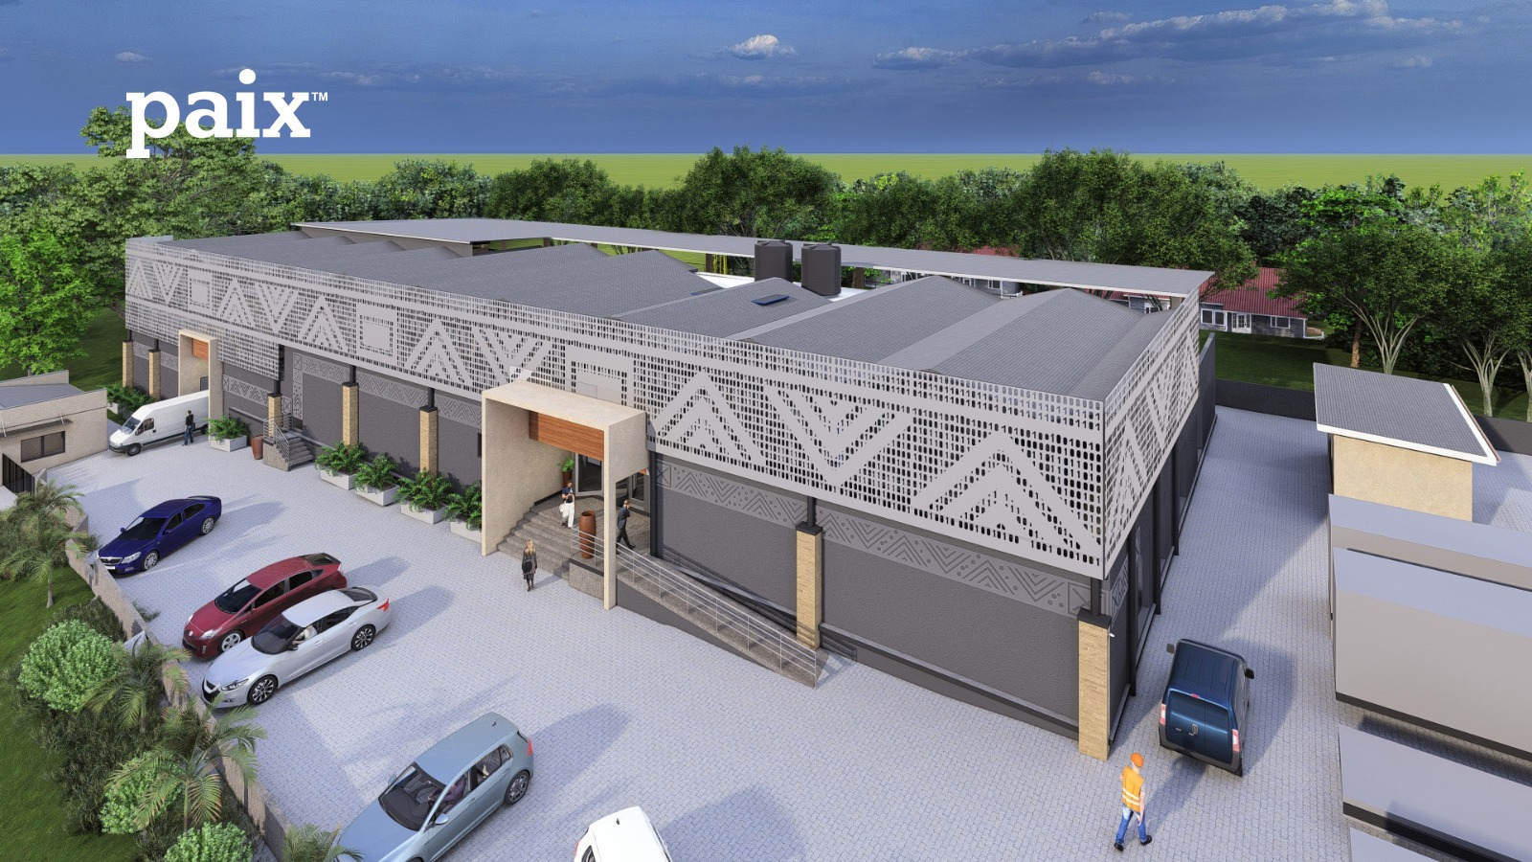
Accra-IX Location
#42 Ring Road Central
Accra Ghana
The Heart of Africa’s Digital Economy
Facility Specifications
The PAIX Community
Carrier Neutral
N+1 Redundancy
Meet-me-Room
2.5MVA Campus Power
Multiple Fiber entry points
- 40+ Carriers
4+ CDNs
4 Telecommunication Companies (All in Country)
Enterprise and Financial Institutions

Slide 12
About PAIX
PAIX Data Centres is a Pan-African provider of cloud- and carrier-neutral colocation data centre services in Africa.
PAIX enables its customers to create value by housing, protecting, and connecting their most valuable applications.
Our products are standardised across all its data centre campuses: Accra, Nairobi, Dakar, Abidjan. More to follow !
The Heart of Africa’s Digital Economy

Slide 13
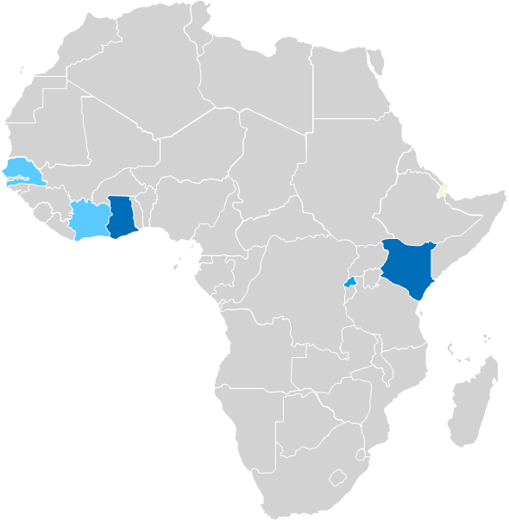
PAIX Locations
Accra - Ghana
#42 Ring Road Central - Accra
Upgrading campus power to 2.5mw
200+ cabinets
Dual power feed to customer equipment
Power Options ( Dual 32A Single phase/50A phase to phase IEC) 2kw – 30kw per cabinet
PeeringDB – PAIX Accra Ghana
Nairobi - Kenya
Britam Tower – Hospital Road
200+ cabinets
Dual power feed to customer equipment
Power Options ( Dual 32A Single phase/50A phase to phase IEC) 2kw – 30kw per cabinet
PeeringDB – PAIX Nairobi
Dakar
Accra
Nairobi
Abidjan
Kigali
Dakar - Senegal
Coming Soon
Kigali - Rwanda
Coming Soon
Live
Development
Abidjan – Cote d’ivoire
Coming Soon

Slide 14
Let’s Take a Tour !

Slide 15
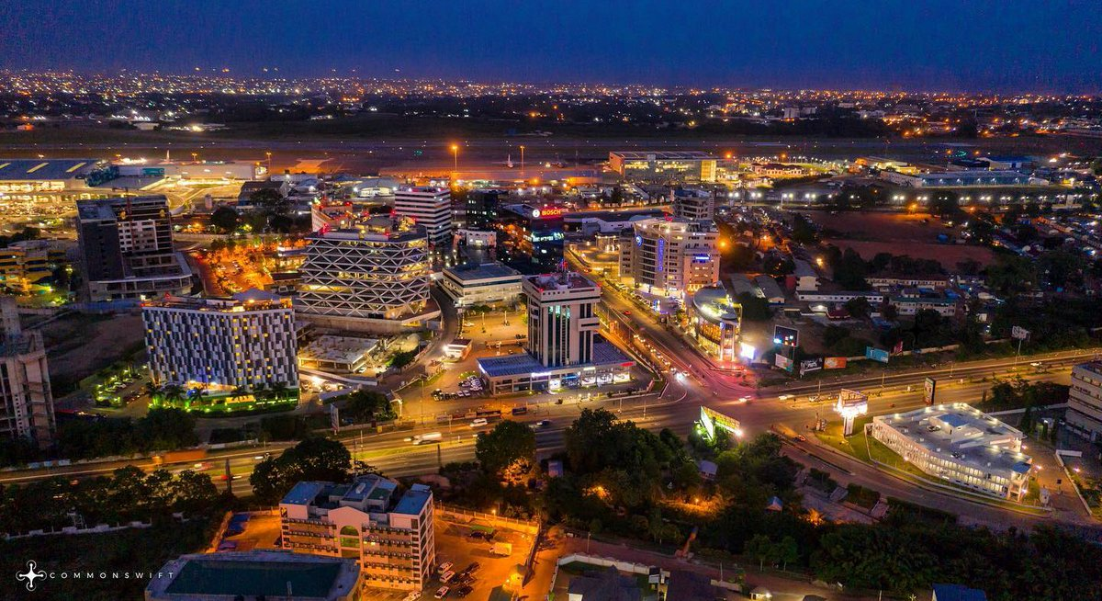
Welcome to Accra

Slide 16
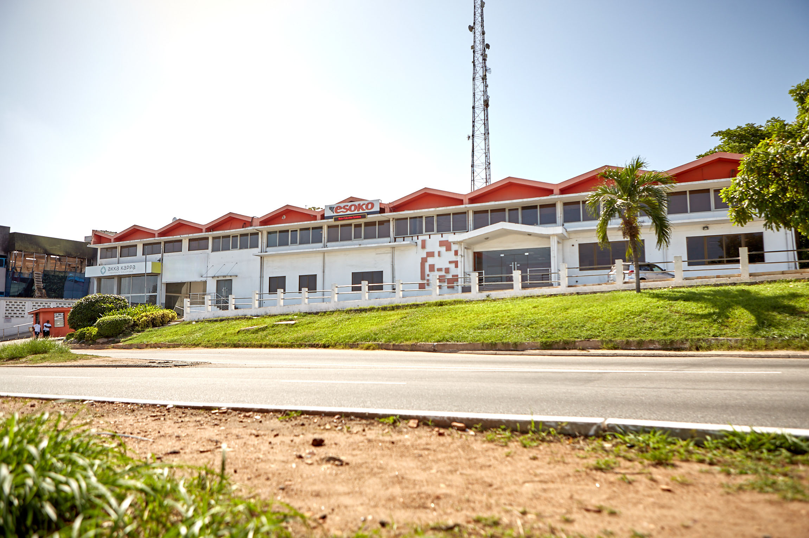
PAIX Accra before the construction of ACC-1.3

Slide 17
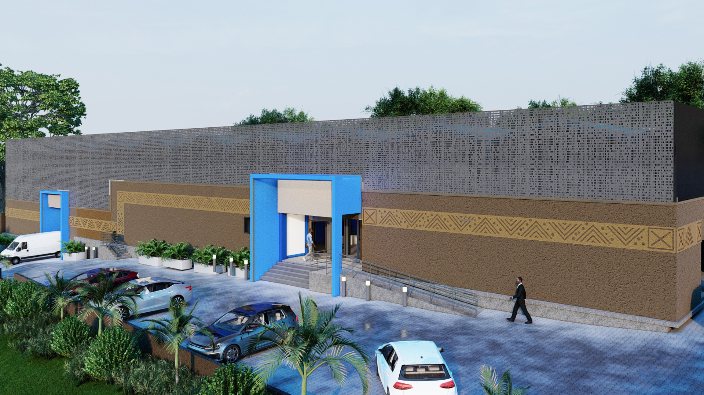
PAIX Accra ACC-1.3 architect’s impression

Slide 18
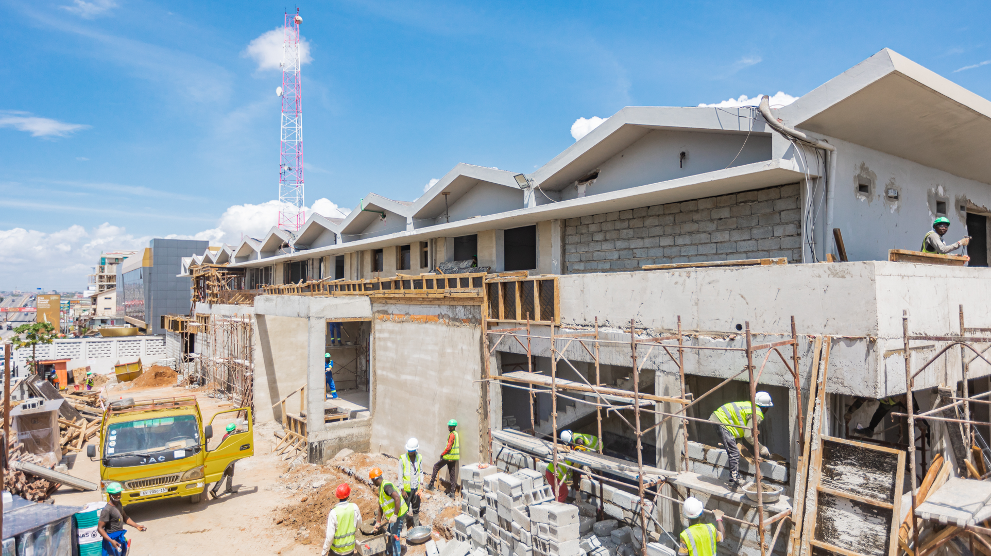

Slide 19
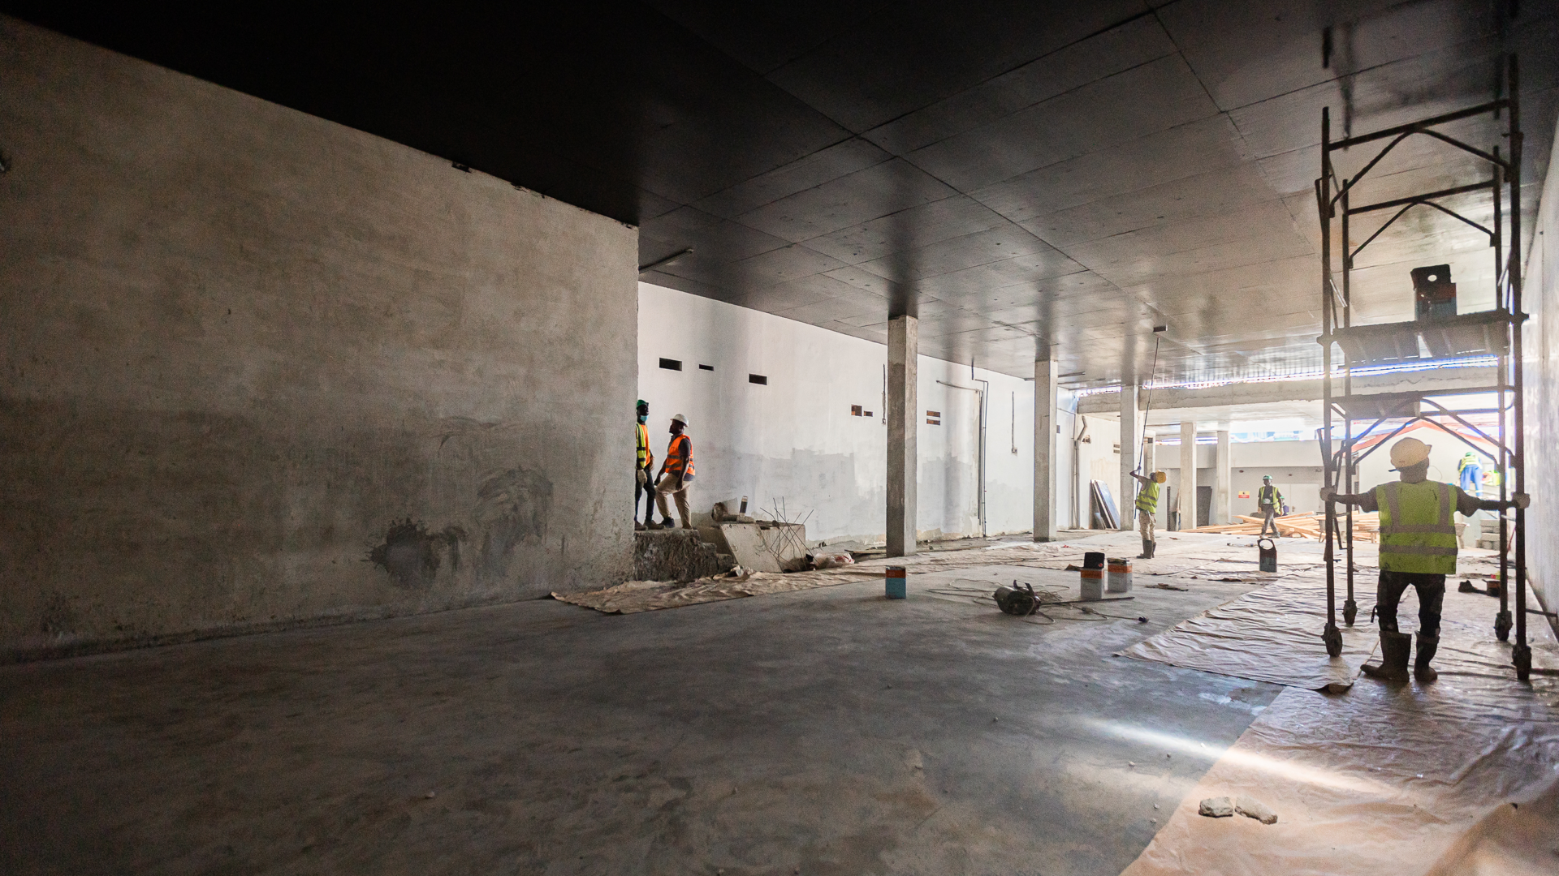

Slide 20
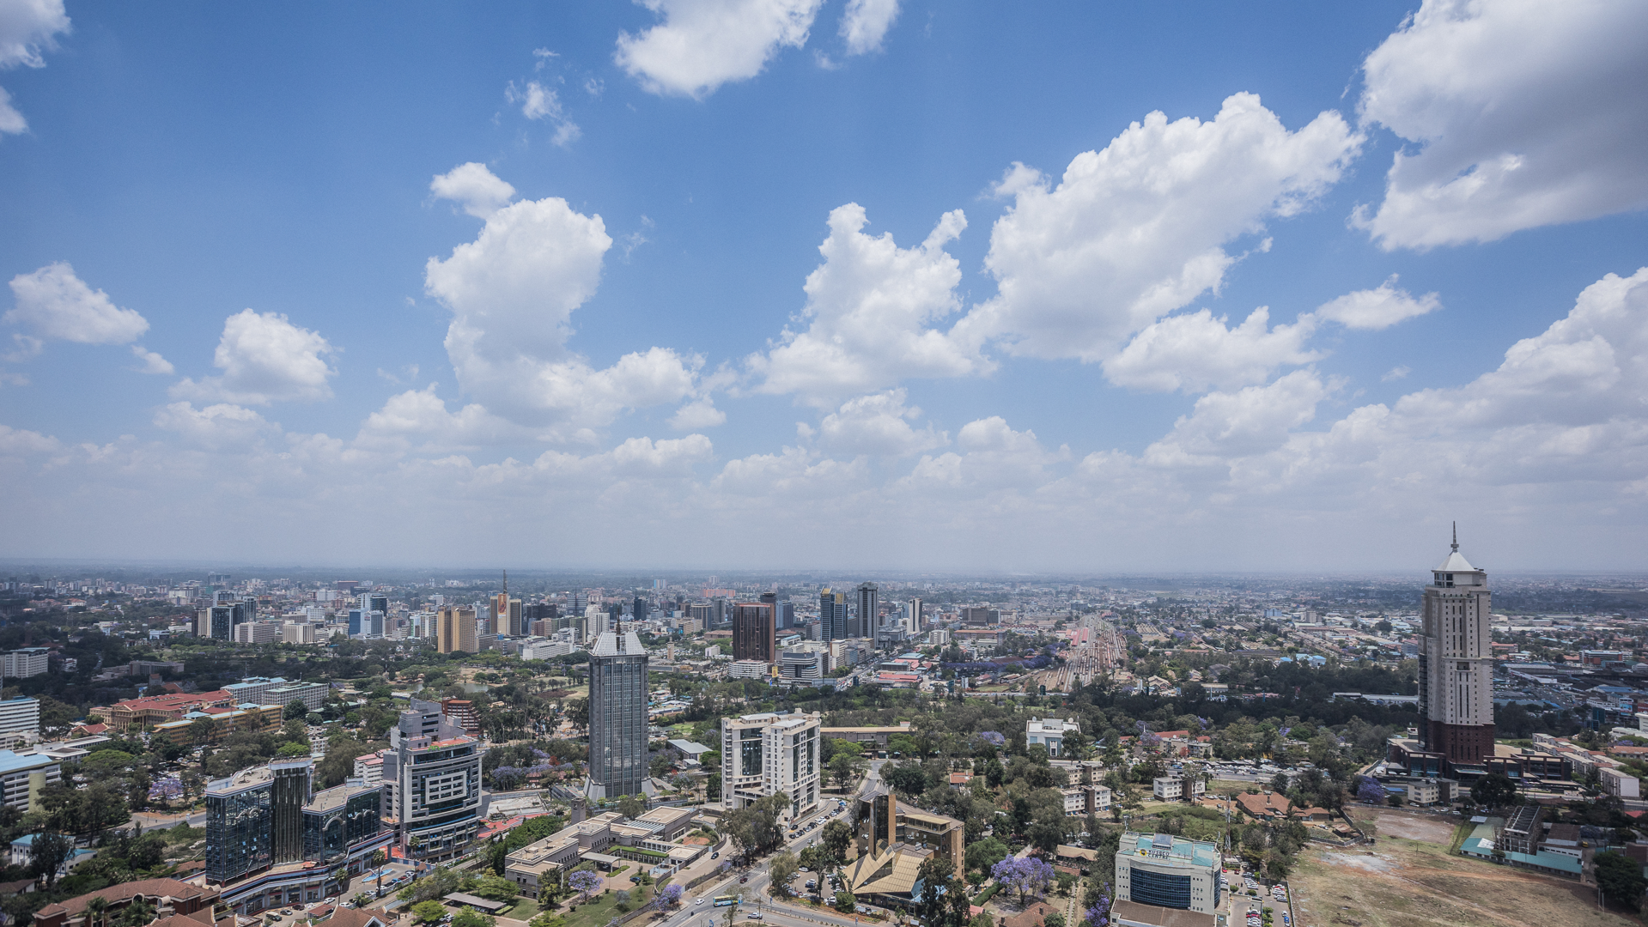
Nairobi

Slide 21
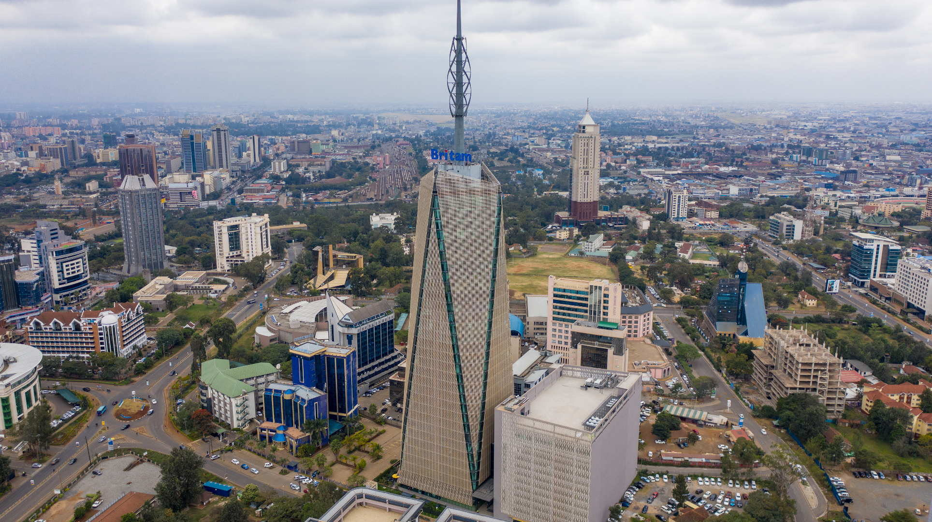

Slide 22
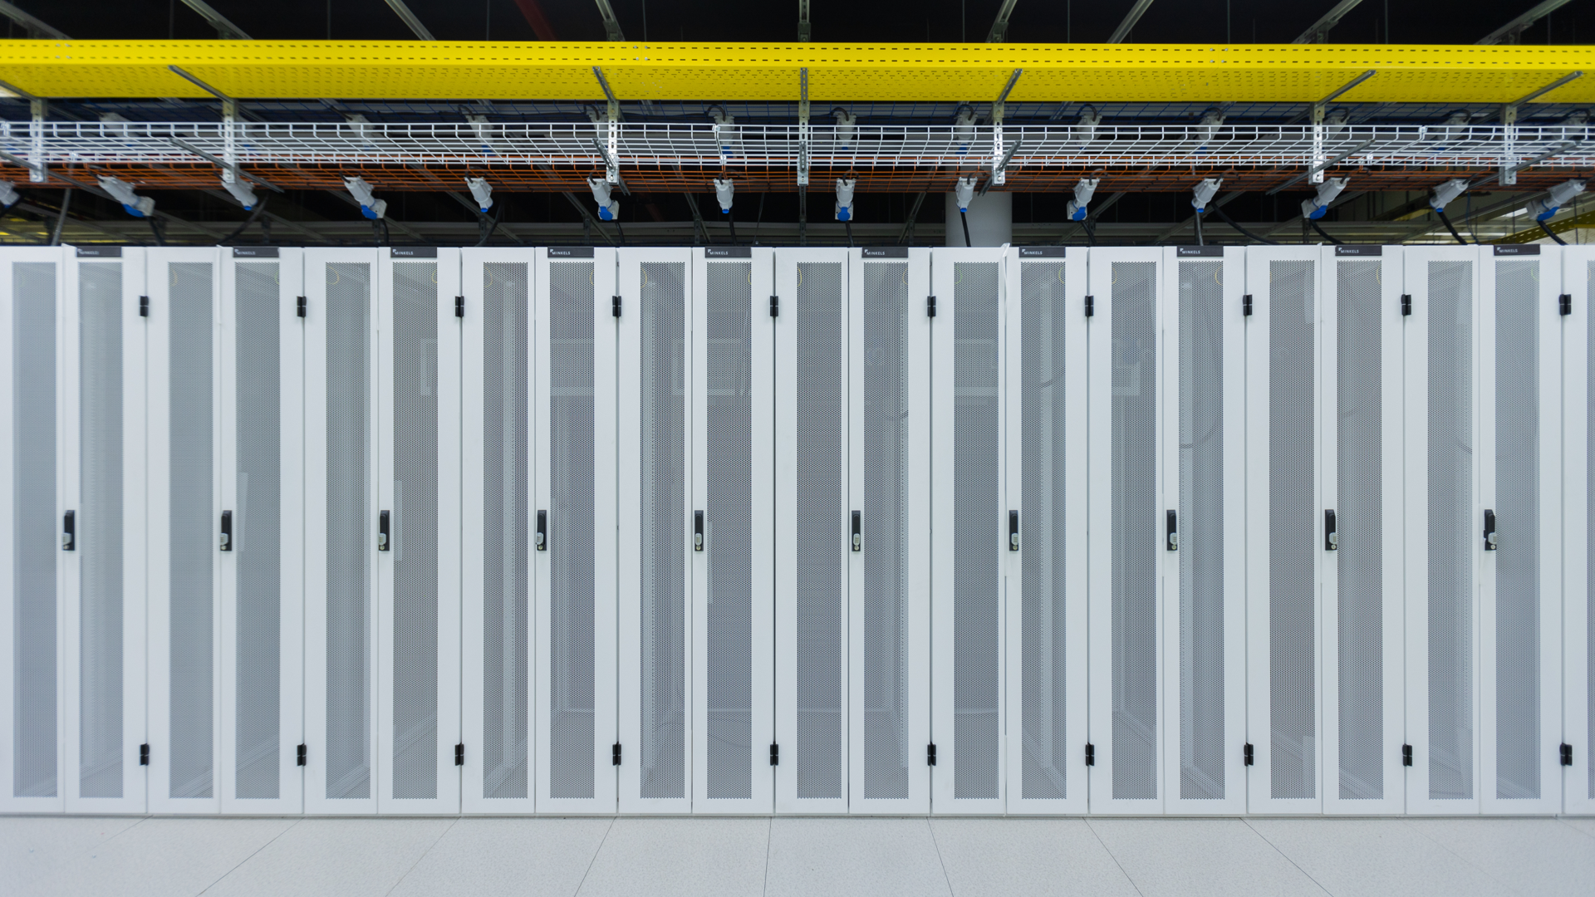

Slide 23
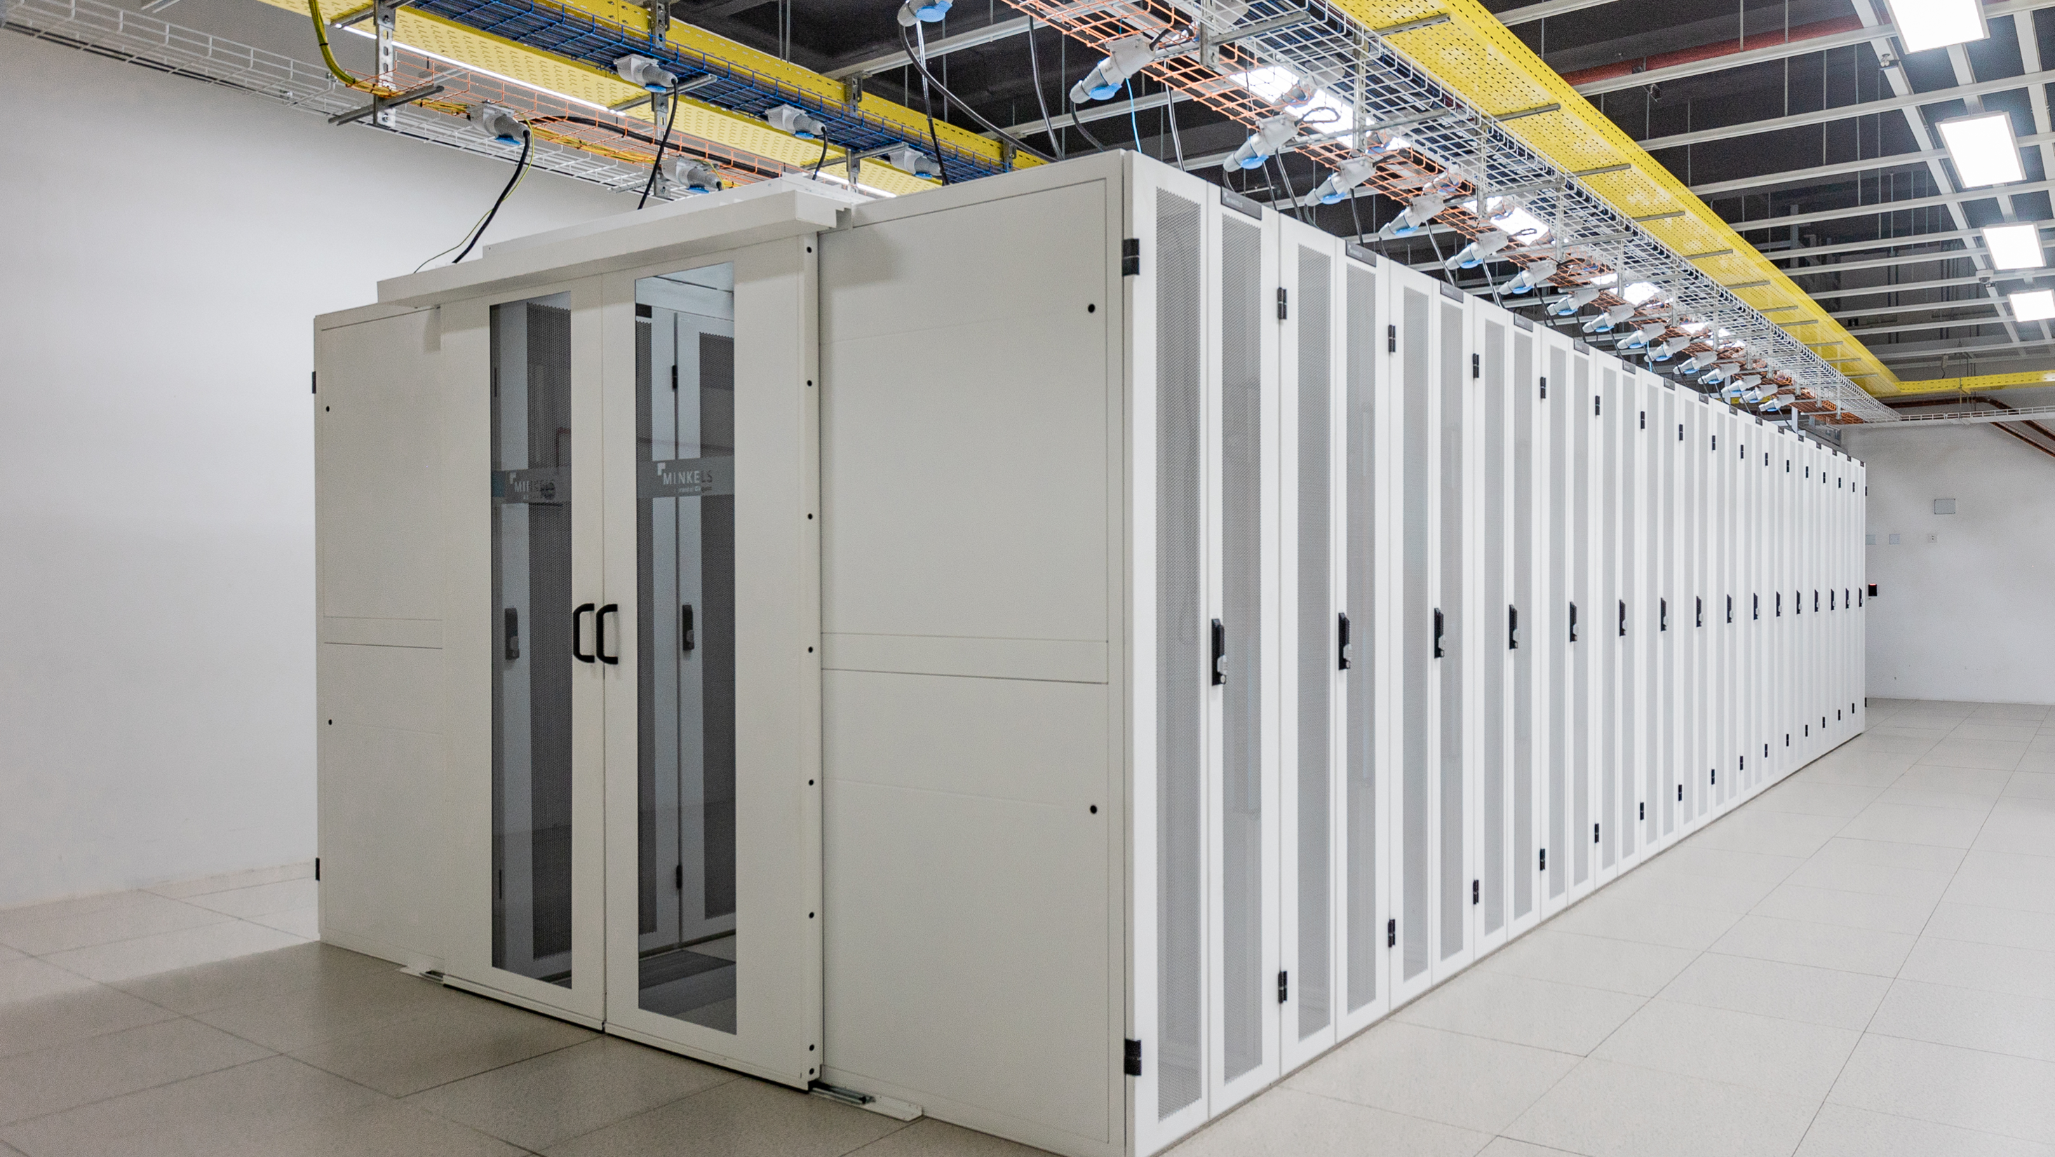

Slide 25
Contact
info@accra-ix.net
+233 207318 897
https://accra-ix.net (Coming Soon)
ASN: 41693
PeeringDB (Coming Soon)

Slide 26
Let’s Connect, Transact, and Grow
(Remember to check if you need a visa for Ghana!)
Thank you

